Slide 1
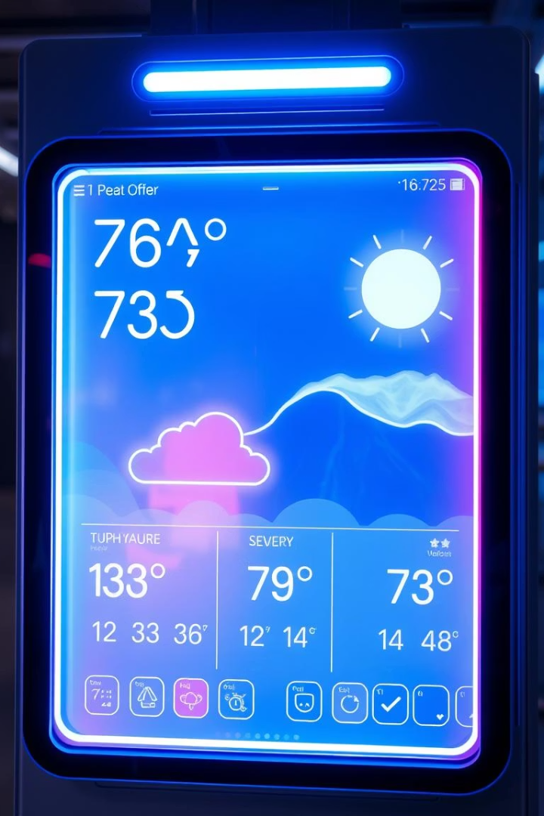

Weather Forecasting Project
Predicting Tomorrow, Today
Team Members: [Akanshu , Sumit Gond]
BCA 3 YEAR _ 6TH SEM
Date: [02-06-2025]

Slide 2
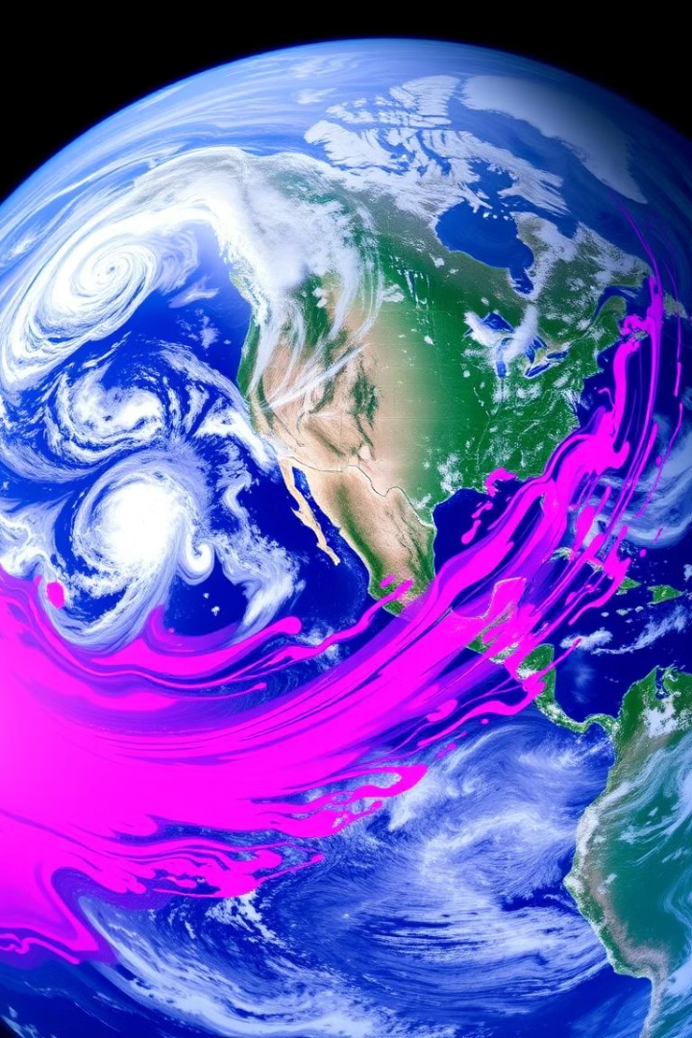




Introduction: Unveiling the Future of Weather
Predicting Conditions
Weather forecasting involves predicting atmospheric conditions for specific locations.
Crucial Impact
It is crucial for agriculture, aviation, and disaster preparedness worldwide.
Market Growth
The global market for weather forecasting systems reached $5.1 billion in 2023.
Steady Expansion
A consistent 4% annual growth rate (CAGR) is predicted for this vital sector.

Slide 3

Project Objective: Precision and Prediction
15%
20%
Accuracy Increase
Loss Reduction
Improve forecast accuracy by 15% using advanced models.
Reduce weather-related losses for local farmers by 20%.
5+
New Sensors
Integrate data from 5+ new weather sensor locations.

Slide 4
Data Collection: A Symphony of Sources
Satellites
Weather APIs
NOAA's GOES-16 provides high-resolution imagery from space.
Data is sourced from OpenWeatherMap and AccuWeather APIs.
Ground Sensors
Historical Data
Local sensors measure temperature, humidity, wind speed, and precipitation.
Over 30 years of archived data from NOAA is utilized.
Radar Data
Doppler radar tracks precipitation intensity and movement.

Slide 5





Technologies Used: Powering the Prediction
Programming Language
AI/ML Models
Cloud Platform
Utilizing TensorFlow and PyTorch for machine learning tasks.
Leveraging AWS, Google Cloud, or Azure for scalable infrastructure.
Python, with libraries like NumPy, Pandas, and Scikit-learn.
Visualization
Matplotlib, Seaborn, and Plotly create insightful data visualizations.

Slide 6





Methodology: From Data to Forecast
Data Cleaning
Handle missing values and remove outliers for data integrity.
Feature Engineering
Create relevant variables to enhance model performance.
Model Selection
Choose the most appropriate AI/ML algorithms for forecasting.
Training
Supervised learning is performed using labeled historical data.
Validation
Model performance is evaluated and parameters are fine-tuned.

Slide 7
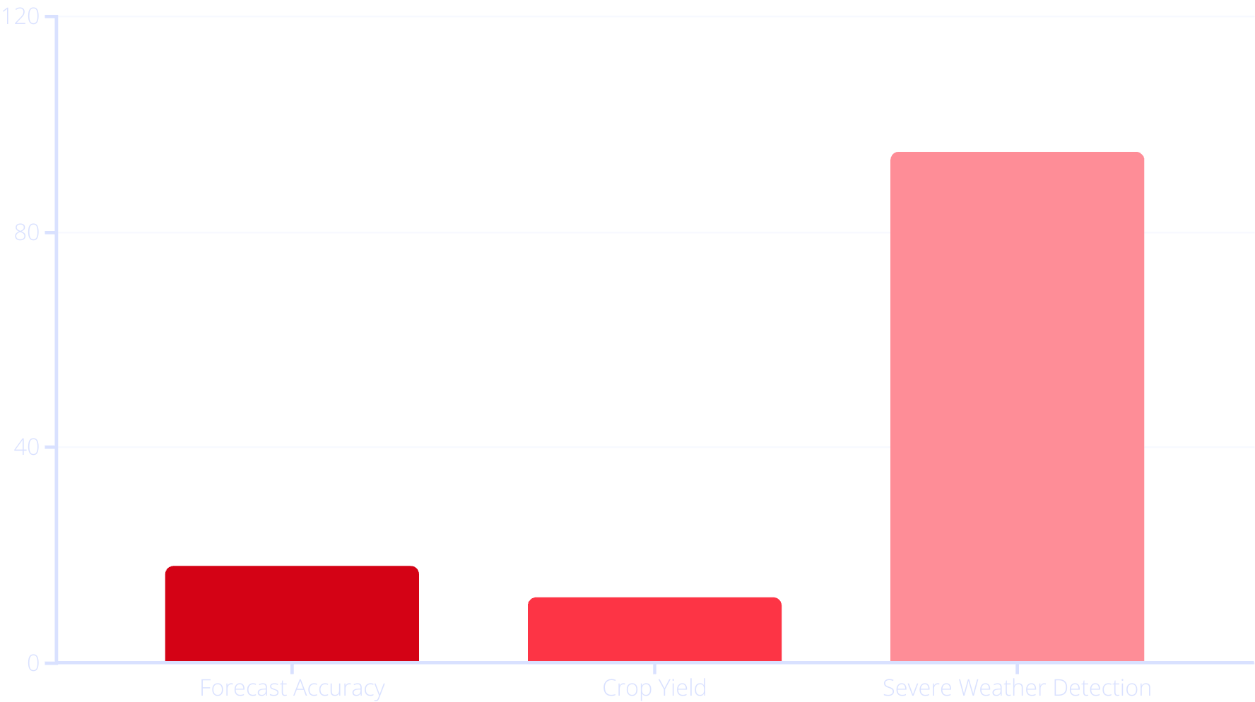
Results: Accuracy in Action
Forecast accuracy improved by 18%, exceeding targets. The mobile app received 10,000+ downloads and a 4.5-star rating. Farmers reported a 12% increase in crop yield. Early warning systems achieved 95% accuracy in severe weather detection.

Slide 8




Conclusion: Charting a Clearer Tomorrow
This project successfully improved forecast accuracy and provided practical applications.
Project Success
Enhanced accuracy and practical application of forecasts.
Future Work
Incorporate climate models, expand coverage for global impact.
Potential
Revolutionize industries relying on weather data, like agriculture and aviation.
Next Steps
Seek partnerships with local municipalities and businesses.

Slide 9




THANK YOU

